Slide 1
Prototype
The Urbananas
Yung Chieh Huang (ych10)
Ji Wu (jw124)
Hanlin Wang (hanlinw4)
Siddharth Salunkhe (ss190)

Slide 2
Task 1: Prompt-and-Draw
User receives a notification to read prompt.
User opens the app and draws from a prompt.
User can upload the art and add personal critiques.
The drawing can occur casually while doing other non-focused tasks like watching Netflix.

Slide 3
Task 1: Existing Solutions
Sketch-a-day app
does not have a personal critique section
tailored to digital art - no camera upload
does not cater to many art styles
does not focus on individual assessment or growth from critique
Notes:
From feedback

Slide 4
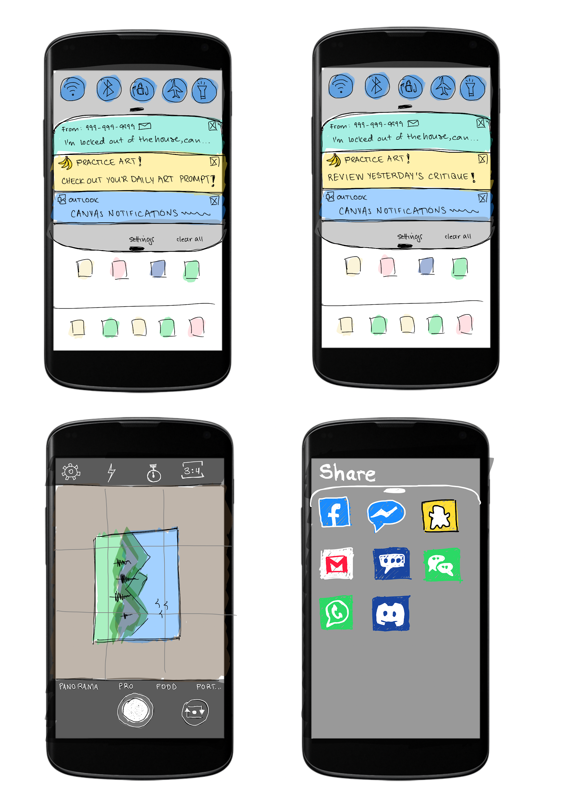
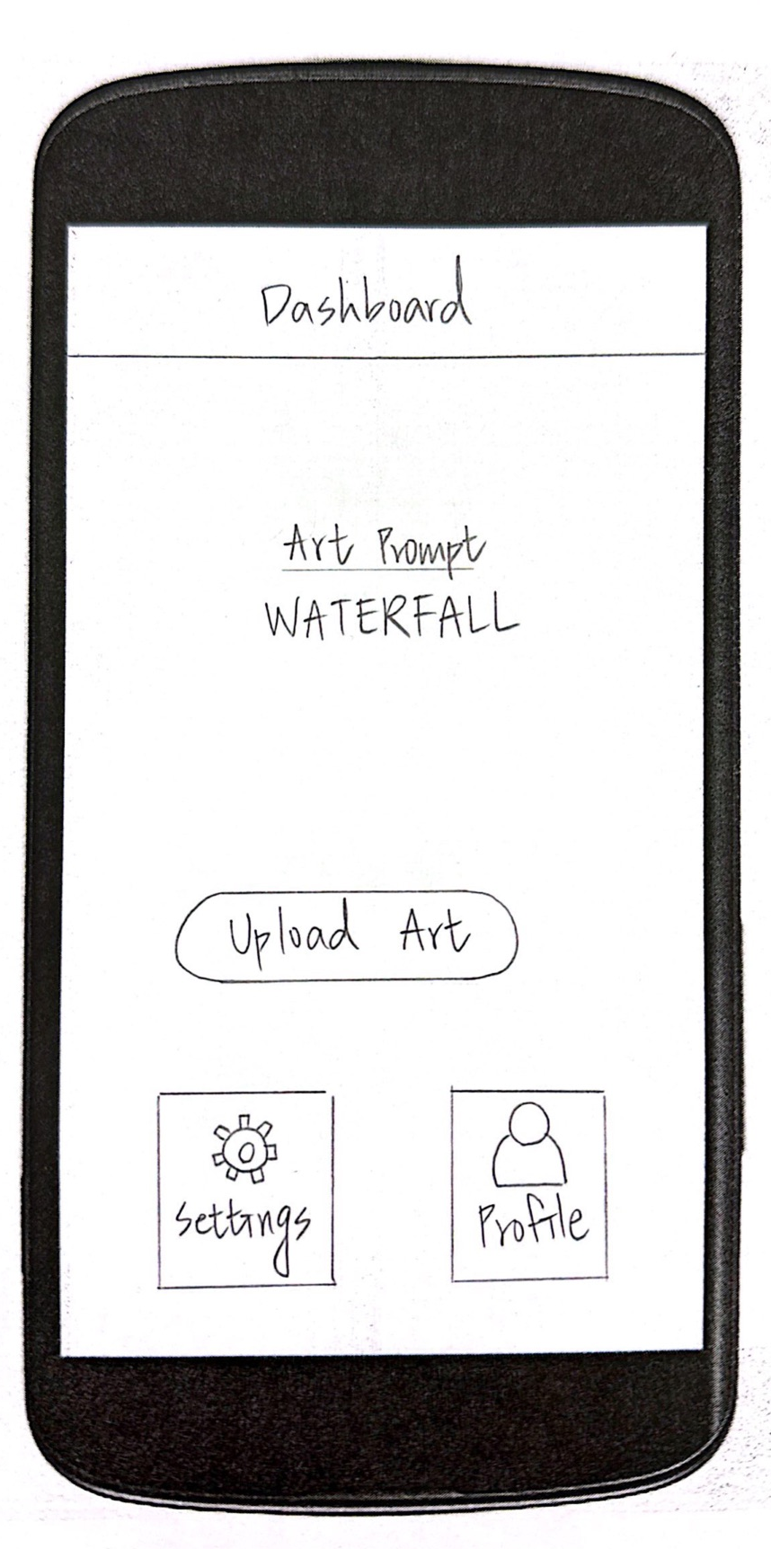
Task 1: Our Prototype
Click Notification

Slide 5
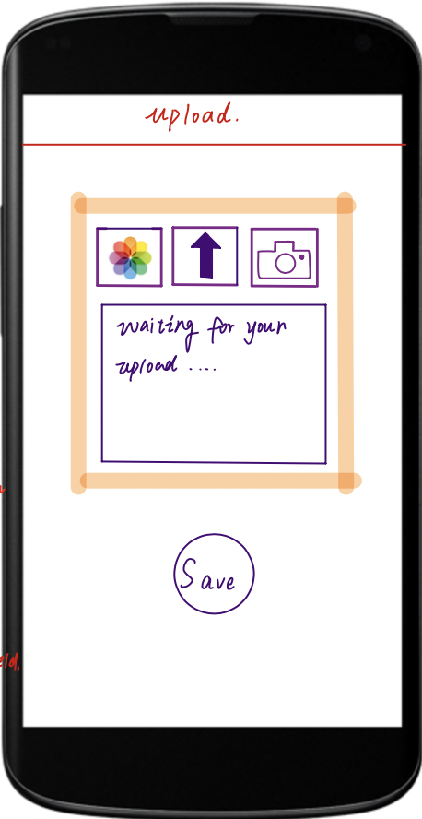
Task 1: Our Prototype
After making a piece of art…
Click Upload

Slide 6
Task 1: Our Prototype
Click Camera

Slide 7
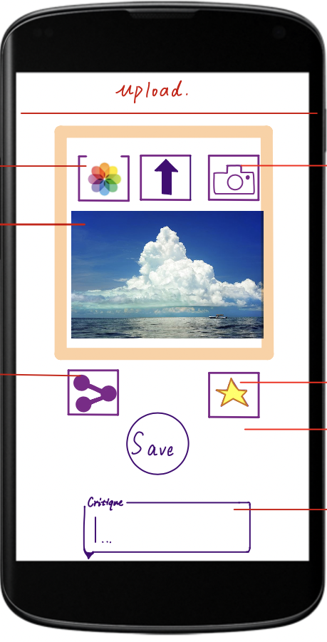
Task 1: Our Prototype
Return To Upload after photo

Slide 8
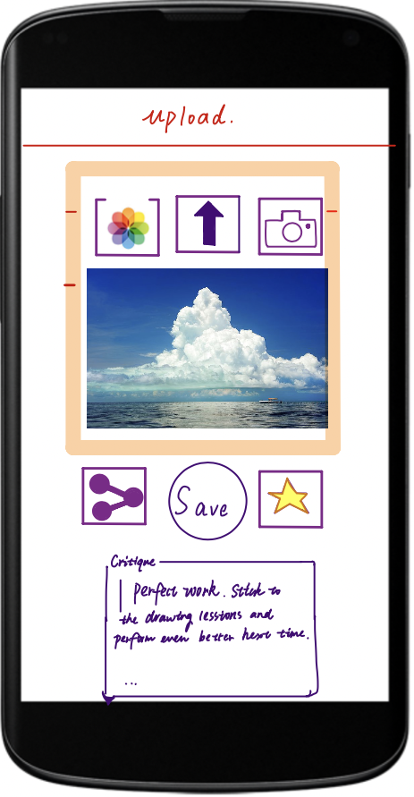
Task 1: Our Prototype
Input Critique

Slide 9
Task 1: Our Prototype
Click Save

Slide 10
Task 1: Our Solution
Has a personal critique section.
Uses camera upload and gallery upload so you can upload any type of art.

Slide 11
Task 2: Shared Works and Critiques
User makes daily progress on a work of art.
User shares that progress with peers for feedback.
User can then go back into the app and update critiques based on when they get feedback from peers.

Slide 12
Task 2: Existing Solutions
Sketch-a-day and Reddit
forum-style comments flood popular users while ignoring other users
does not let you post generic art - must be from prompt
Overall: does not allow much flexibility in the content of what you share and does not solicit targeted feedback from peers

Slide 13
Task 2: Our Prototype
Click Notification

Slide 14
Task 2: Our Prototype
Click Upload

Slide 15
Task 2: Our Prototype
Click the Camera

Slide 16
Task 2: Our Prototype
Return To Upload

Slide 17
Task 2: Our Prototype
Click Share

Slide 18
Task 2: Our Prototype
Click Save

Slide 19
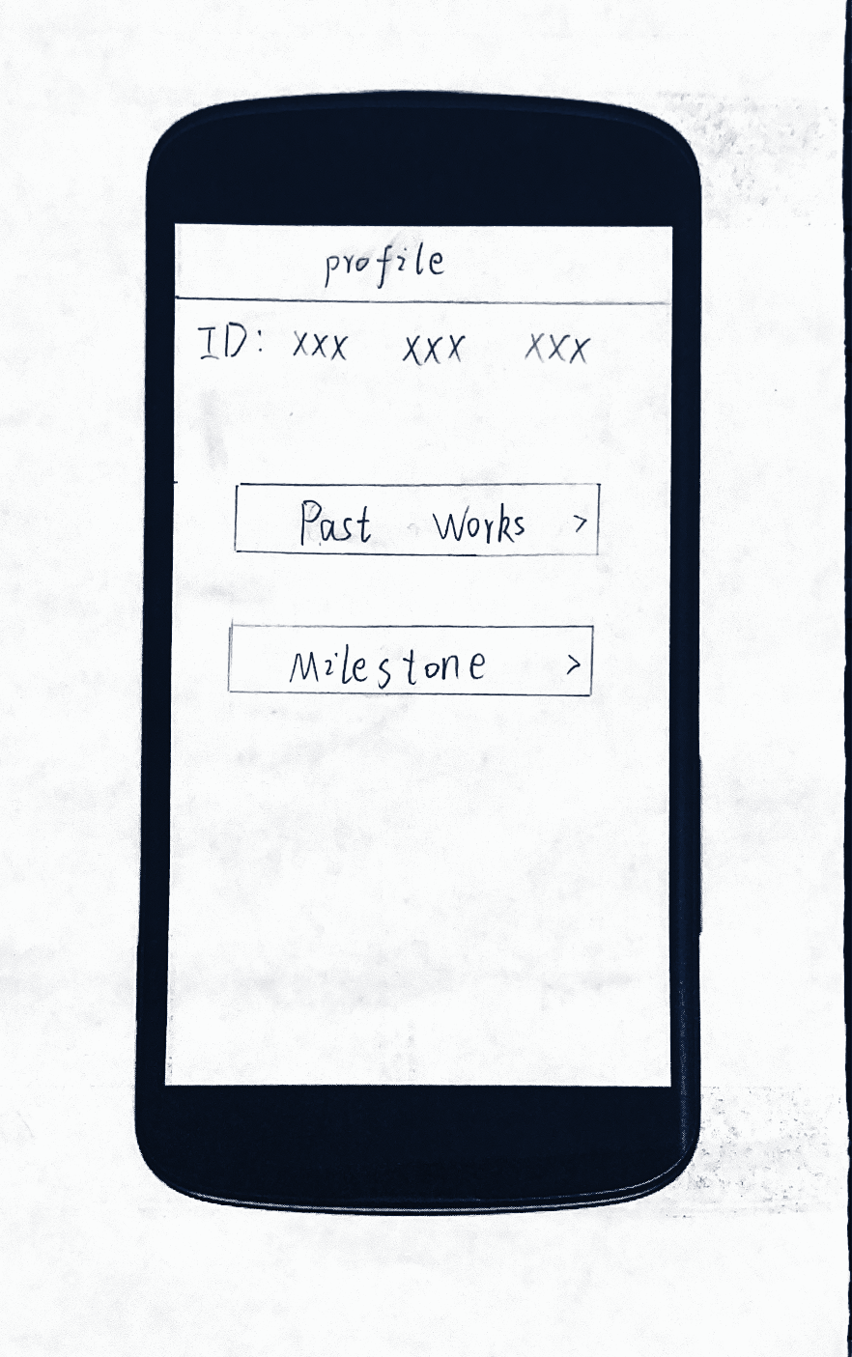
Task 2: Our Prototype
After getting feedback…
Click Profile

Slide 20
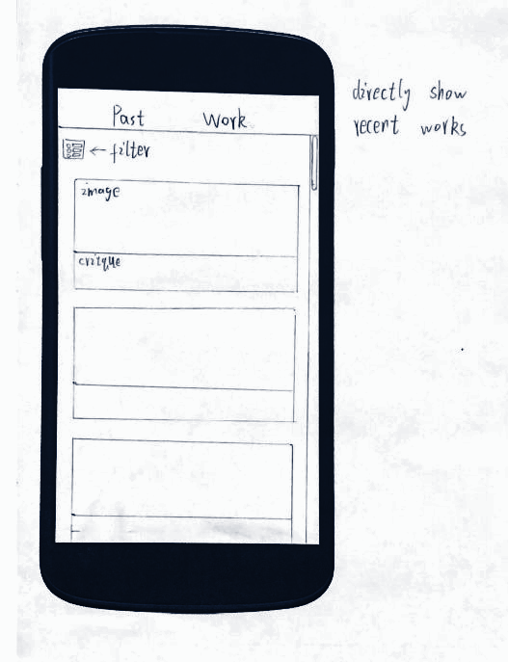
Task 2: Our Prototype
Click View Past Works

Slide 21
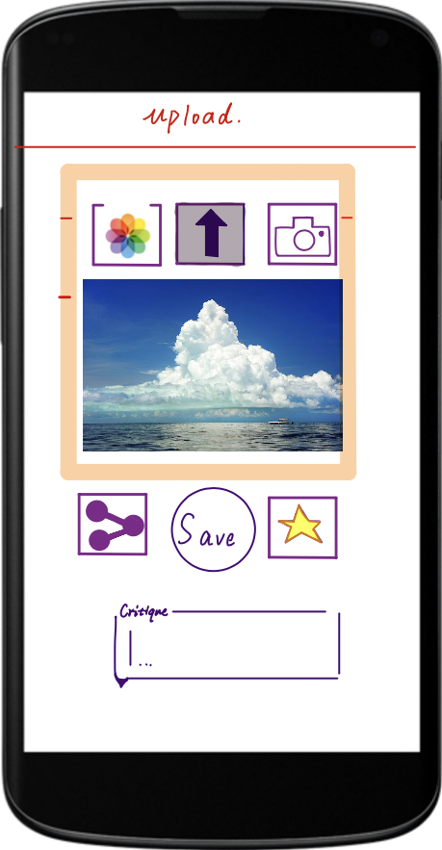
Task 2: Our Prototype
Click On Image

Slide 22
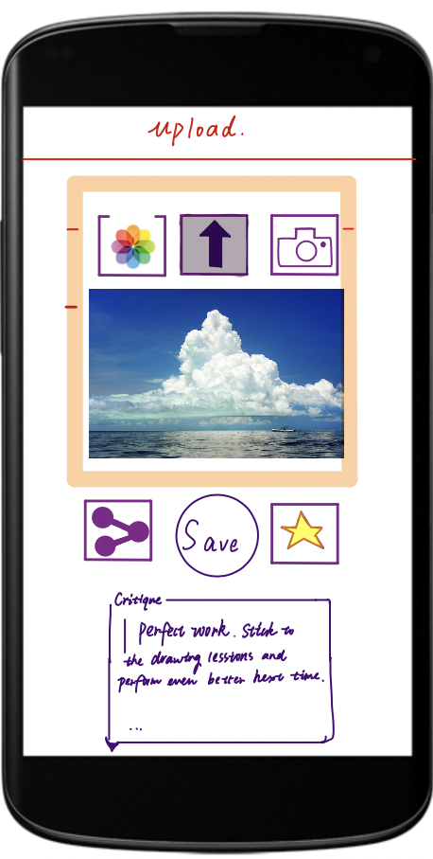
Task 2: Our Prototype
Input Critique

Slide 23
Task 2: Our Prototype
Click Save

Slide 24
Task 2: Our Solution
Allows easy sharing via social media to get personal feedback from peers.
Lets you update critiques when you receive new feedback.
Lets you upload without any particular prompt so it does not constrain your art.

Slide 25
Task 3: Viewing Milestones
User has been practicing a while and wants to view progress.
User views past works and milestones to see accomplishments and growth.

Slide 26
Task 3: Existing Solutions
Streaks app
Simplistic milestone - number of consecutive days
Sketch-a-day app
No milestones that involve addressing critiques
No milestones that involve completed works over time
No milestones that highlight favorite works
Overall: too simplistic extrinsic motivator that is not concretely linked to intrinsic motivators such as seeing personal growth

Slide 27
Task 3: Our Prototype
Click Profile

Slide 28
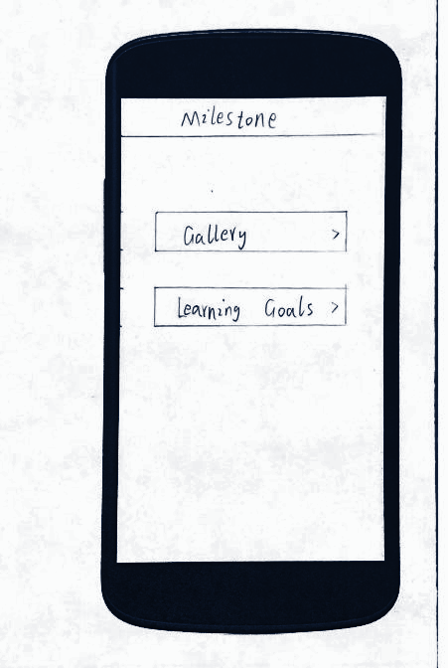
Task 3: Our Prototype
Click Milestones

Slide 29
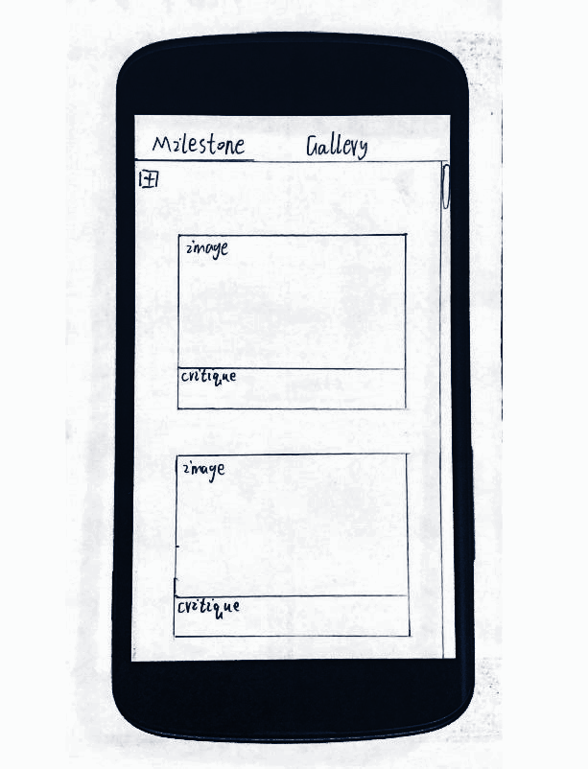
Task 3: Our Prototype
Click Gallery

Slide 30
Task 3: Our Prototype
Click Back Button

Slide 31
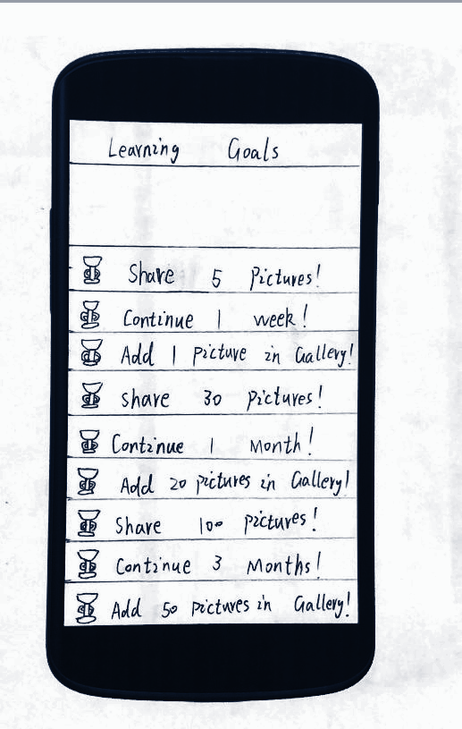
Task 3: Our Prototype
Click Learning Goals

Slide 32
Task 3: Our Solution
Useful, personalized milestones that capture growth through more than raw numbers.
View personal milestones as works of art.
Has milestones that reward long-term interaction.

Slide 33
Changing notification settings
Not an actual task.
For completeness - has its own workflow.
Most users will go through this process.

Slide 34
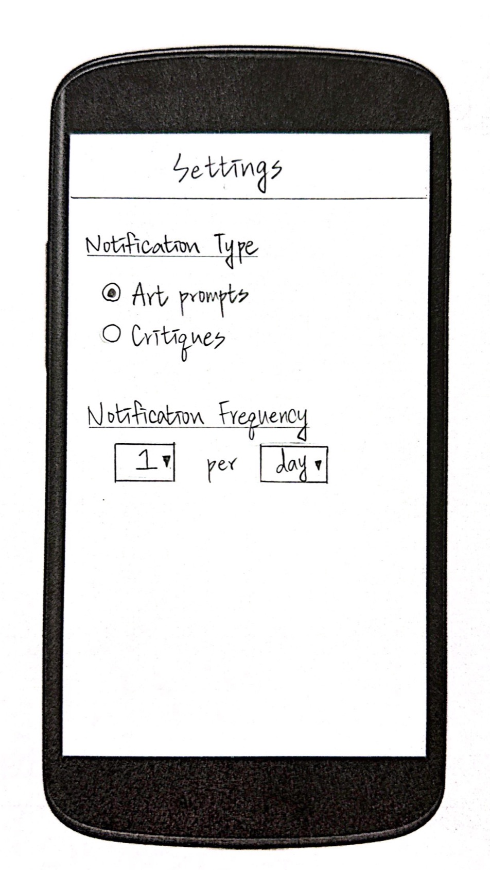
Auxiliary Tasks: Settings Page
Click Settings

Slide 35
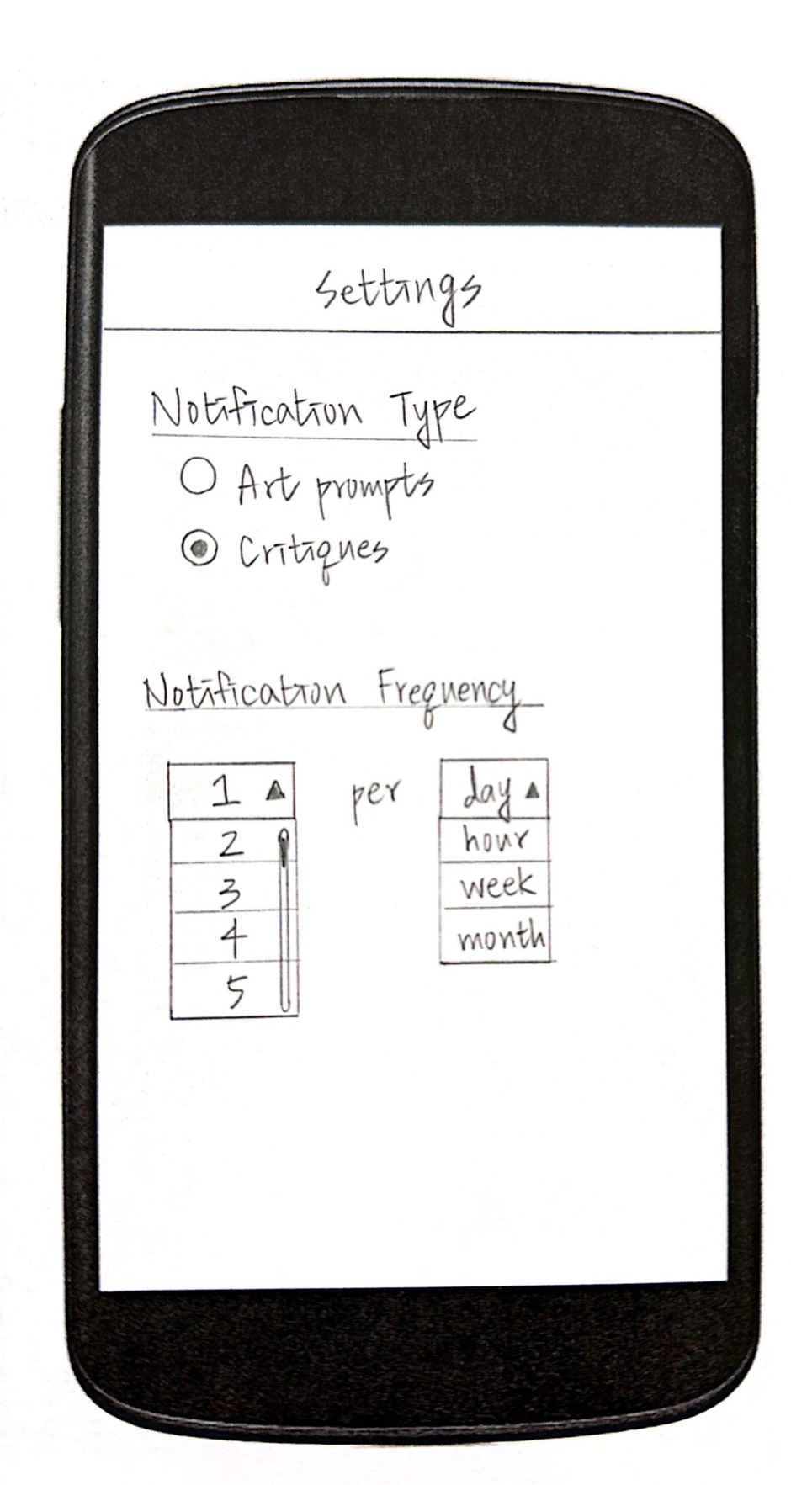
Auxiliary Tasks: Settings Page
Click Dropdowns to set options
Save Changes
Save Changes

Slide 36
Auxiliary Tasks: Settings Page
Click Save Changes
Save Changes

Slide 37
Thank you!

Slide 38
Figures

Slide 39
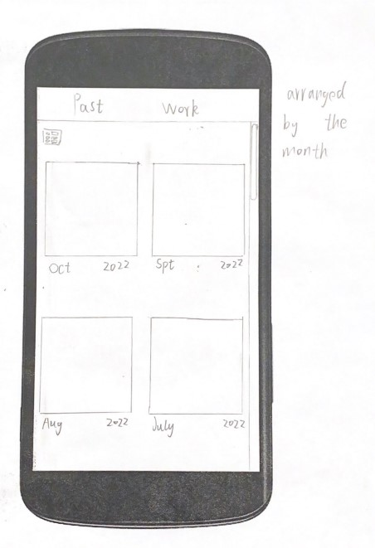
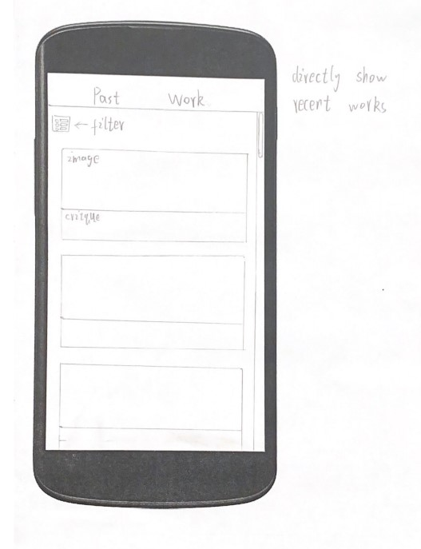

Slide 42
